Slide 1
Software Testing and Quality Assurance
Haiming Liu
liuhaiming@bjtu.edu.cn
School of Software Engineering
Beijing Jiaotong University

Slide 2
Notes:
这里也是开始尝试用思维导图来进行知识点的整理

Slide 3
16 Weeks Plan
Week 1: The basic concepts and theories of testing
Week 2-3: Principles of Testing
Week 4: Testing the specification
Week 5-6: Black Box Testing
Week 7-9: White Box Testing
Week 10: Integration Testing and System Testing
Week 11: Usability Testing and Accessibility Testing
Week 12: Security Testing
Week 13: Mutation Testing
Week 14: Software Quality
Week 15: Review I
Week 16: Review II

Slide 4
Testing the specification

Slide 5

Testing the specification
You do not need to have code to start testing.
Testing the specification can save on time and cost later on.
Also, mistakes in specifications account for about 55% of all bugs.
The specification is typically a written document using prose and pictures to describe the functional and non-functional aspects of the software.
Notes:
检查产品说明书
您不需要代码即可开始测试。
测试产品说明数可以节省时间和成本。
同样，产品说明数错误占所有错误的55％左右。
该产品说明数通常是使用文字和图片描述软件功能和非功能方面的书面文档。

Slide 6
Testing the specification
The product specification is a written document using words and pictures to describe the intended product
Basic goal: To understand the problem as perceived by the user.
Activities of specification are problem oriented.
Focus on what, not how (this is design)
Don’t cloud the specification with unnecessary detail.
Don’t pre-constrain design in the specification.
After specification is done, do software design:
solution oriented
how to implement the what
Notes:
要对SPEC进行审查，首先我们要知道什么是SPEC
软件需求Specification：概述
基本目标：了解用户所感知的问题。
Specification的活动是以问题为导向的。
Specification完成后，进行软件设计：

Slide 7
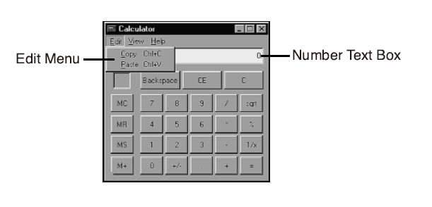
Testing the specification
Windows Calculator
The Edit menu will have two selections: Copy and Paste. These can be chosen by one of three methods: pointing and clicking with the mouse, using access-keys (Alt+C for Copy and Alt+P for Paste), or using the standard Windows shortcut keys of Ctrl+C for Copy and Ctrl+V for Paste.
The Copy function will copy the current entry displayed in the number text box into the Windows Clipboard. The Paste function will paste the value stored in the Windows Clipboard into the number text box.

Slide 8
Testing the specification
An Overview
Key to specification is good communication between customer and developers.
Work from specification document as guide.
Basically, it’s the process of determining and establishing the precise expectations of the customer about the proposed software system.
Notes:
产品说明书的关键是客户与开发人员之间的良好沟通。
以产品说明书文档为指导。
基本上，这是确定和建立客户对拟议软件系统的准确期望的过程。

Slide 9
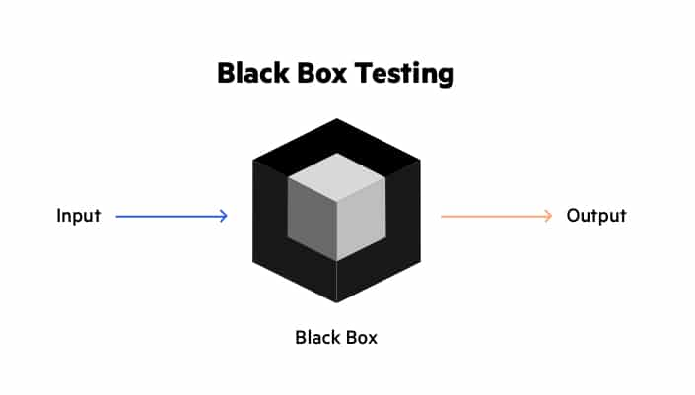
White-box testing
Black Box Testing is the method that does not consider the internal structure, design, and product implementation to be tested.
In other words, the tester does not know its internal functioning. The Black Box only evaluates the external behavior of the system. The inputs received by the system and the outputs or responses it produces are tested.

Slide 10
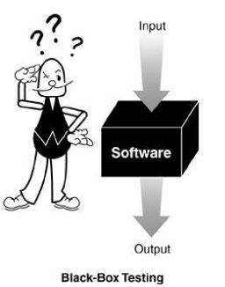
Black-box testing
Characteristics of Black-box testing:
Program is treated as a black box.
Implementation details do not matter.
Requires an end-user perspective.
Criteria are not precise.
Test planning can begin early.
Black-box testing, also called functional testing or behavioral testing
Notes:
黑盒测试的特点：
程序被视为黑匣子。
实施细节无关紧要。
需要最终用户的观点。
条件不精确。
测试计划可以提早开始。

Slide 11
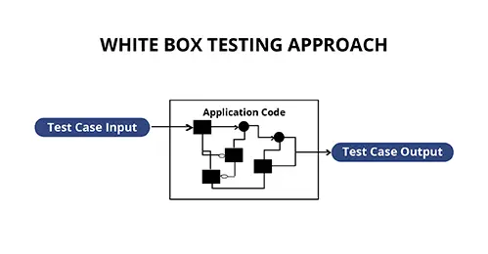
White-box testing
In white-box testing (sometimes called clear-box testing), the software tester has access to the program’s code and can examine it for clues to help him with his testing—he can see inside the box. Based on what he sees, the tester may determine that certain numbers are more or less likely to fail and can tailor his testing based on that information.
It is also called glass box testing or clear box testing or structural testing.

Slide 12
Static Testing is a type of a Software Testing method which is performed to check the defects in software without actually executing the code of the software application. Static testing is performed in early stage of development to avoid errors as it is easier to find sources of failures and it can be fixed easily. The errors that can’t not be found using Dynamic Testing, can be easily found by Static Testing.
Dynamic Testing is a type of Software Testing which is performed to analyze the dynamic behavior of the code. It includes the testing of the software for the input values and output values that are analyzed.
Notes:
静态测试指的是 测试不运行的部分，检查和审核
动态测试要求 使用和运行软件

Slide 13
Testing the specification
The purpose of specification
Raw user requirements are often:
vague
contradictory
impractical or impossible to implement
overly concrete
just plain wrong
The purpose of specification is to get a usable set of requirements from which the system may be designed and implemented, with minimal “surprises”.
Notes:
原始用户需求通常是：
模糊的
矛盾的
不切实际或无法实施
过于具体只
是错误的
产品说明书的目的是以最小的“意外”获得一组可用的需求，从中可以设计和实施系统。

Slide 14
Testing the specification
The Specification document
The official statement of what is required of the system developers.
Includes system models, requirements definition, and requirements specification.
Not a design document.
States functional and non-functional requirements.
Serves as a reference document for maintenance.
Notes:
项目规范文档
有关系统开发人员要求的正式声明。
用作维护的参考文件。

Slide 15
Testing the specification
Two kinds of requirements
Functional: The precise tasks or functions the system is to perform.
e.g., details of a flight reservation system
Non-functional: Usually, a constraint of some kind on the system or its construction
e.g., expected performance and memory requirements, process model used, implementation language and platform, compatibility with other tools, deadlines, ...
Notes:
功能性：系统要执行的精确任务或功能。
非功能性的：通常是对系统或其结构的某种约束

Slide 16
Testing the specification
Specification document “requirements”
Should be easy to change as requirements evolve.
Must be kept up-to-date as system changes.
Foreseen problems:
“won’t support Win-3.x apps”
Expected evolution:
“will port to MacOS in next version”
Response to unexpected events/usage:
“if input data in old format, will auto-convert”
Notes:
产品说明书里的需求
应随需求的发展而轻松更改。
系统更新时必须保持最新。
预见的问题
预期的发展：
对意外事件/使用的响应：

Slide 17
Testing the specification
Software Requirements Specification Structure
Introduction (describe need for system)
Functional Requirements
Non-Functional Requirements
System Evolution (describe anticipated changes)
Glossary (technical and/or new jargon)
Appendices
Index

Slide 18
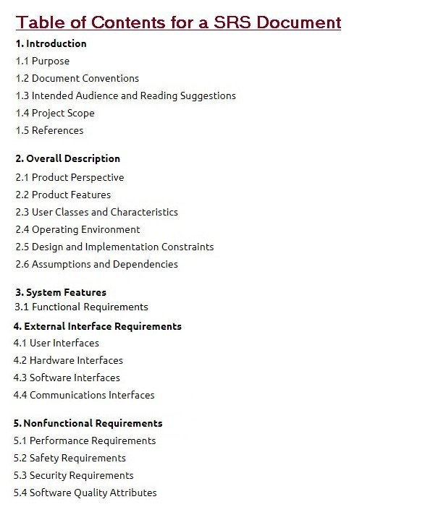
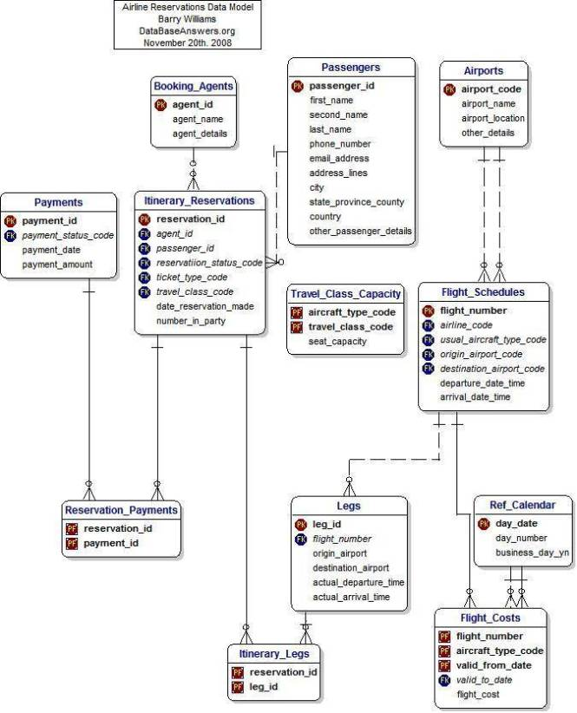
Testing the specification
Specification structure
Notes:
Software Requirements Specification

Slide 19
Testing the specification
To summarize …
Specification focuses on determining what the customer wants, and not how it will be implemented.
Specification is hard to get correct; it requires good communication skills.
Requirements may change over time.
Requirements specification requires iteration.
The customer often doesn’t have good grasp of what he wants.
Bugs created in the requirements stage are very expensive to fix later.
Notes:
产品说明书侧重于确定客户需要什么，而不是如何实现它。
产品说明书很难正确； 它需要良好的沟通能力。
需求可能会随着时间而变化。
需求规格说明需要迭代。
客户通常对自己想要的东西不太了解。
在需求阶段创建的错误在以后修复时非常昂贵。

Slide 20
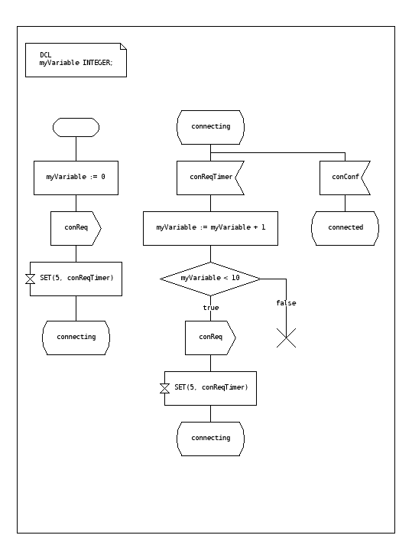
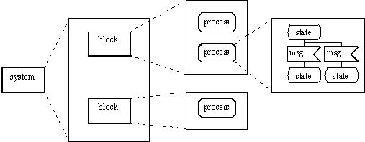
Testing the specification
Specification Languages and Tools
SDL (Specification and Description Language)
SDL is a specification language targeted at the unambiguous specification and description of the behaviour of reactive and distributed systems.

Slide 21
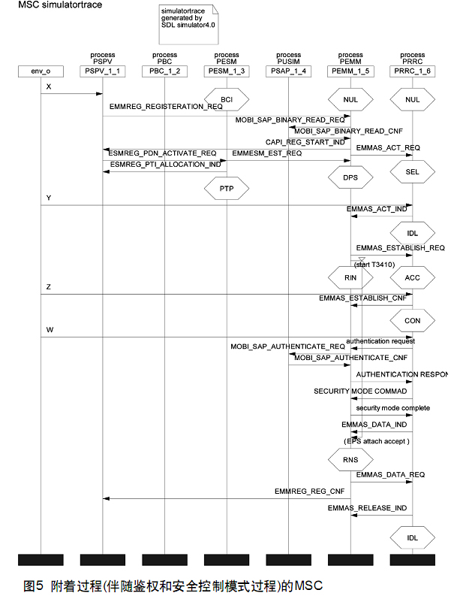
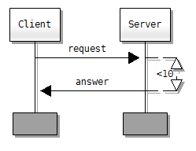
Testing the specification
Specification Languages and Tools
MSC (Message Sequence Chart)
MSC is an interaction diagram from the SDL family standardized by the International Telecommunication Union.

Slide 22
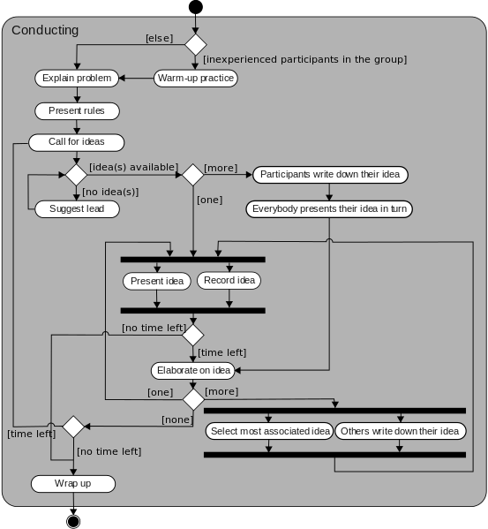
Testing the specification
Specification Languages and Tools
UML (Unified Modeling Language)
UML is a general-purpose, developmental, modeling language in the field of software engineering, that is intended to provide a standard way to visualize the design of a system.

Slide 23
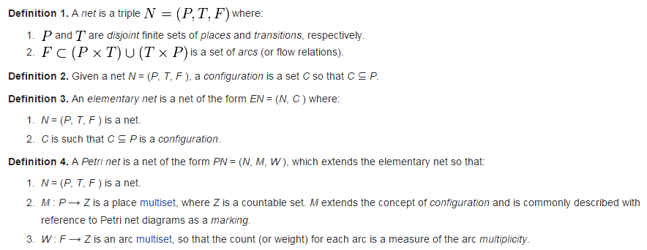
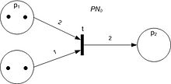
Testing the specification
Specification Languages and Tools
Petri Net
Petri Net is one of several mathematical modeling languages for the description of distributed systems.

Slide 24
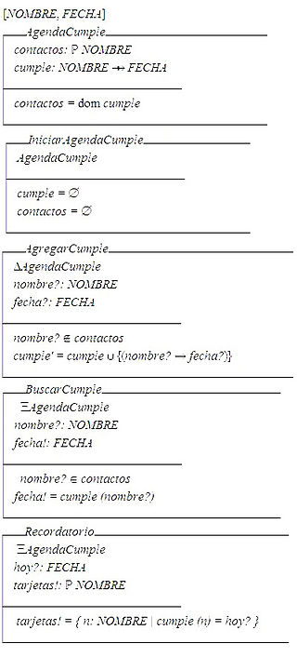
Testing the specification
Specification Languages and Tools
Z notation
Z notation is a formal specification language used for describing and modelling computing systems. It is targeted at the clear specification of computer programs and computer-based systems in general.

Slide 25
Testing the specification
Specification reviews
Involve people examining the specification with the aim of discovering anomalies and defects.
Reviewers reuse domain knowledge so they are likely to have seen the types of error that commonly arise.
Does not require the execution of a system so may be used before implementation.
Effective technique for discovering errors.
Notes:
让人们检查规范，以发现异常和缺陷。
不需要执行系统，因此可以在实施之前使用。
发现错误的有效技术。

Slide 26
Testing the specification
Reviews and testing
Reviews and testing are complementary and not opposing verification techniques.
Both should be used during the V & V process.
Reviews can check conformance with a specification but not conformance with the customer’s real requirements.
Reviews cannot check non-functional characteristics such as performance, usability, etc.
Notes:
审查和测试是互补的，并不与验证技术相反。
两者都应在V＆V过程中使用。
审核可以检查是否符合规范，但不能符合客户的实际要求。
评论无法检查非功能性特征，例如性能，可用性等。

Slide 27
Testing the specification
Review pre-conditions
A precise specification must be available.
Team members must be familiar with the organization standards.
Management must accept that reviews will increase costs early in the software process.
Management must not use reviews for staff appraisal.
Notes:
必须提供精确的规格。
团队成员必须熟悉组织标准。
管理层必须接受审查将在软件过程的早期增加成本。
管理层不得将评论用于员工评估。

Slide 28
Testing the specification
What is a specification review?
A process of identifying faults in the specification of a software system.
Review should uncover both errors made in producing specification documents, and errors made earlier in the requirements engineering process.
Notes:
识别软件系统规范中的错误的过程。
审查应发现在生产规格文件时所犯的错误以及在需求工程过程中较早时所犯的错误。

Slide 29
Testing the specification
Limitations of conventional review approaches
Too much information to go through, and not enough time to do it thoroughly.
Unfamiliarity of individual reviewers with the overall goals of the design.
No single part of the specification gets a thorough and complete evaluation.
One-on-one interaction between individual reviewers and specification team is limited.
Notes:
常规审查方法的局限性
信息太多
总体目标不熟悉。
没有得到全面而完整的评估。
互动有限。

Slide 30
Testing the specification
Better method: Active specification review process
Change from “general” review to a set of more focused reviews.
Use questionnaires to engage the reviewer in using the specification.
More opportunities for one-on-one discussion between reviewer and specification team.
Notes:
更好的方法：主动规范审查过程

Slide 31
Testing the specification
An example
We have been asked to review the specification for a hospital’s order processing system.
The order processing system allows users to order items for patients, such as tests or medications.

Slide 32
Testing the specification
Active specification review process Step 1: Prepare the specification for review
Think about what criteria reviewers will use:
Well-structured
Simple
Adequate
Flexible
Practical
Easy to implement
Standardized

Slide 33
Testing the specification
Active specification review process Step 2: Prepare the documentation for review
Make assumptions explicit
System can record the order pertaining to a patient.
It is possible to obtain all the orders for a patient.
System can determine and change the status of an order.
The order always contains at least one item.
The status of an order is always in one of the two states i.e active or cancelled.
Incorrect Usage Assumptions
Cannot add or remove items once the order is placed.
Once an order is cancelled, the status cannot be set to active again.
An item is always added with respect to an order.

Slide 34
Testing the specification
Active specification review process Step 3: Identify the specialized reviews
Focus the reviewer’s attention on specific properties of the specification (e.g., data access).
Data access sufficiency.
E.g., provides all data required by the other features of the system.
Assumption Sufficiency.
E.g., contains all of the assumptions needed to access the feature’s data.

Slide 35
Testing the specification
Active specification review process Step 4: Identify the reviewers needed
People with different perspectives and expertise are needed as reviewers
Programmers and analysts who worked on the other features of the order processing system.
Programmers and analysts familiar with hospital information systems in general.

Slide 36
Testing the specification
Active specification review process Step 5: Design the questionnaires
Make reviewers take an active role
Make reviewers use the documentation
Phrase questions in an active way
E.g., “Write down the exceptions that can occur” rather than “Are exceptions defined for every program?”

Slide 37
Testing the specification
Active Specification Review Process Step 6: Conduct the review
Present an overview of the specification.
Assign reviews to the reviewers.
Reviewers complete their reviews, meeting with the specification authors as needed.
Specification authors review completed questionnaires, and meet with reviewers to resolve questions.
Specification authors produce new version of the specification.

Slide 38
Testing the specification
Specification attribute checklist
Completeness
Accuracy
Precision
Consistency
Relevance
Feasibility
Code/Design-free
Testability
Notes:
产品说明书属性检查清单
完整性
准确性
精确
一致性
关联
可行性
无代码/无设计
可测性

Slide 39
Testing the specification
Specification terminology checklist
Always, every, all, none, never, … (absolutely sure?)
Certainly, therefore, clearly, obviously, customarily, most, … (persuasion lingo)
Some, sometimes, often, usually, ordinarily, customarily, most, … (vague)
Etc., and so forth, and so on, such as, … (not testable)
Good, fast, cheap, efficient, small, stable, … (unquantifiable)
Handled, processed, rejected, skipped, eliminated, …
If … then … (missing else)
Notes:
产品说明书用语检查清单
1、总是、每一种、所有、没有、从不。
2、当然、因此、明显、显然、必然。
3、某些、有时、常常、通常、惯常、经常、大多、几乎。
4、等等、诸如此类、依次类推、例如。
5、良好、迅速、廉价、高效、小、稳定。
6、处理、进行、拒绝、跳过、排除。
7、如果...那么...（没有否则）。

Slide 40
Testing the specification
Conclusions
Reviewers focus on those areas they are best suited to evaluate
Time is used more wisely for all participants
More errors are likely to be found
One-on-one communication with specification authors makes it easier for people to speak up.
Few errors found does not necessarily indicate that the specification is good.
E.g., Perhaps the review process was not effective.
Notes:
审稿人专注于最适合评估的领域
与产品说明书作者的一对一交流使人们更容易说话。
几乎没有发现错误并不一定表明该规范是正确的。

Slide 41
Testing the specification
You now know …
… what a specification is
… how to review (test) a specification
… the benefits of an “active” specification review process
Notes:
…什么是产品说明书
…如何查看（测试）产品说明书
…“积极的”产品说明书审查流程的好处

Slide 42
To be continued… See you next week

